Slide 1
Understanding Treatment of Narcotic Addiction in Pregnancy and the Role of Breastfeeding in Assisted Recovery
Jaye M Shyken, MD
St Louis University School of Medicine
Oct 3, 2018

Slide 2
I Have No Financial Conflict of Interest to Report

Slide 3
2017 Opioid Addiction in the US
In 2016, 11.8 million Americans age 12 or older misused opioids (4.4%)
11.5 million misused prescription pain relievers
950,000 used heroin
>640,000 used both
2.1 million had a substance use disorder (7.8% of the population)
Center for Behavioral Health Statistics and Quality. (2017). Key substance use and mental health indicators in the United States: Results from the 2016 National Survey on Drug Use and Health Retrieved from http://www.samhsa.gov/data/
Notes:
Of those diagnosed with a substance abuse disorder in 2016, only 1 in 5 got treatment,

Slide 4
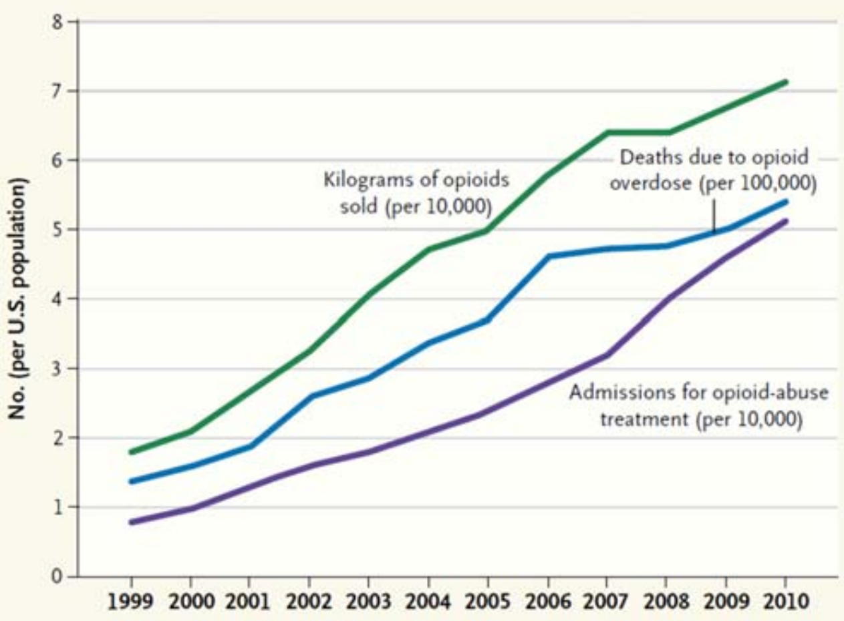
Prescription opioids: 1999-2010
80% of the world’s oral opioids are used in the US
CDC, MWWR 2011
Notes:
80% of heroin users initially used Rx opioids
80% of the world’s oral opioids are used in the US

Slide 5
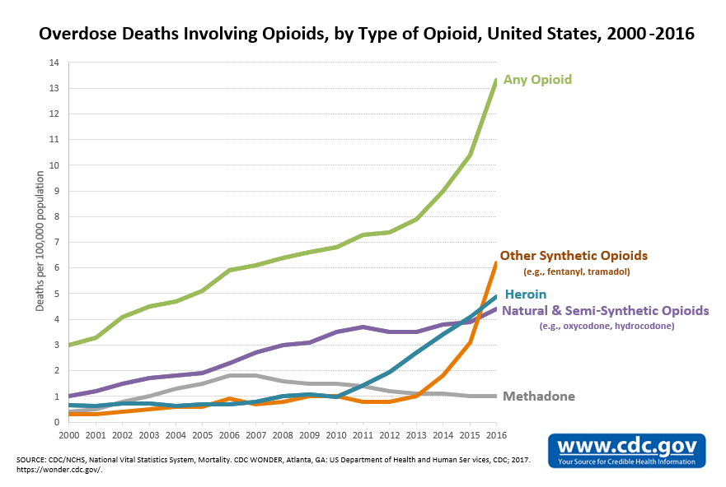
64,400 overdose deaths in 2016
42,249 with any opioid
15,469 with heroin
33,900 with natural and synthetic opioids (except methadone)

Slide 6
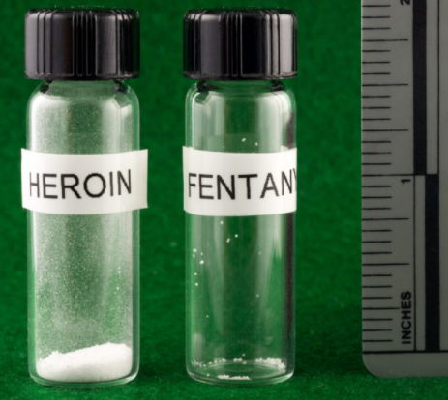
Why are people dying?
Lethal doses

Slide 7
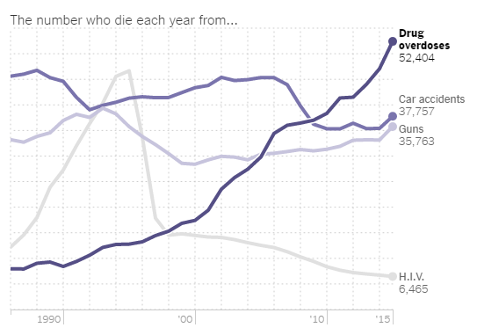
Drug Overdose Death Rate in Comparison

Slide 8
Missouri Opioid Deaths in 2017
https://health.mo.gov/data/opioids/index.php#data
Notes:
Good news is that although the OD death rate increased over the previous year, it only increased by 4.7% over 2016. Between 2015 and 2016 there was a 35% increase.

Slide 9
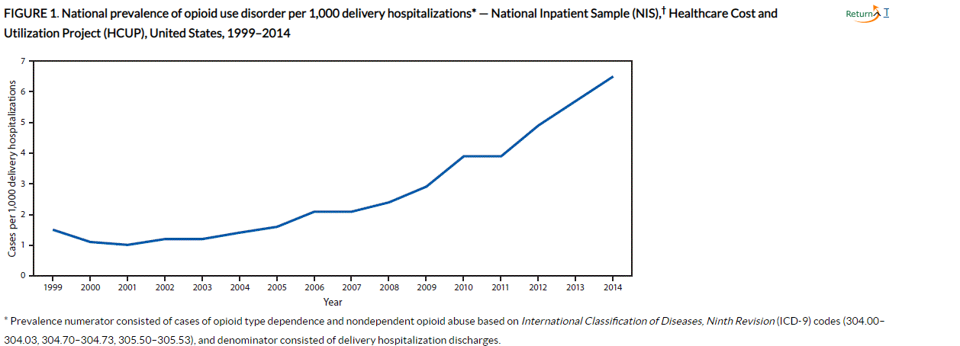
Opioid Use Disorder at Delivery, 1999-2014
Haight SC, Ko JY, et al. MMWR August 10, 2018;67(31);845-9
Notes:
Data from Healthcare Cost and Utilization Project.
Prevalence of OUD quadrupled from 1.5/1000 delivery hospitalizations to 6.5/1000
Based on ICD9 codes of all deliveries in the US,

Slide 10
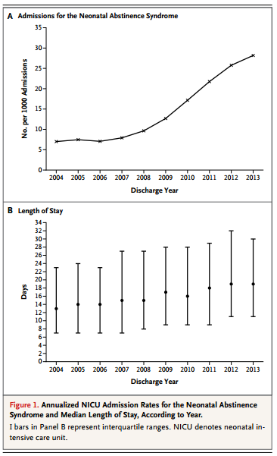
Increasing Incidence of NAS in US NICUs
Tolia VN, et al. NEJM 2015;372;2118-26, DOI:10.1056/NEJMsal500439
Notes:
Methods:
Using multiple cross-sectional analyses and a de-identified data set
analyzed data from infants with the neonatal abstinence syndrome from 2004 through 2013 in 299 neonatal intensive care units (NICUs) across the United States to look at trends
RESULTS:
Among 674,845 infants admitted to NICUs, we identified 10,327 with the neonatal abstinence syndrome. From 2004 through 2013, the rate of NICU admissions for the neonatal abstinence syndrome increased from 7 cases per 1000 admissions to 27 cases per 1000 admissions; the median length of stay increased from 13 days to 19 days (P<0.001 for both trends). The total percentage of NICU days nationwide that were attributed to the neonatal abstinence syndrome increased from 0.6% to 4.0% (P<0.001 for trend), with eight centers reporting that more than 20% of all NICU days were attributed to the care of these infants in 2013. Infants increasingly received pharmacotherapy (74% in 2004-2005 vs. 87% in 2012-2013, P<0.001 for trend), with morphine the most commonly used drug (49% in 2004 vs. 72% in 2013, P<0.001 for trend).
CONCLUSIONS:
From 2004 through 2013, the neonatal abstinence syndrome was responsible for a substantial and growing portion of resources dedicated to critically ill neonates in NICUs nationwide.

Slide 11
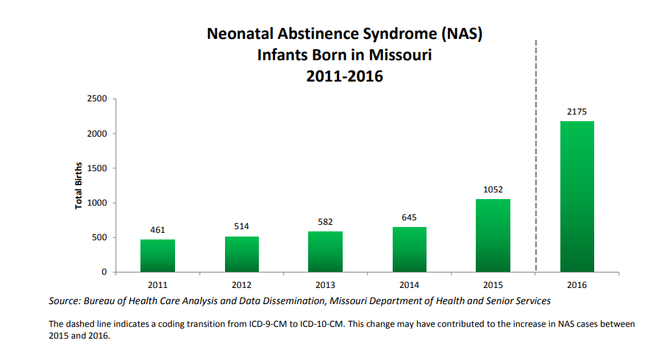
Notes:
Dashed line indicates change in coding from ICD9 to ICD10
There was a 372% increase in NAS counts in just six years (2011-2016).

Slide 12
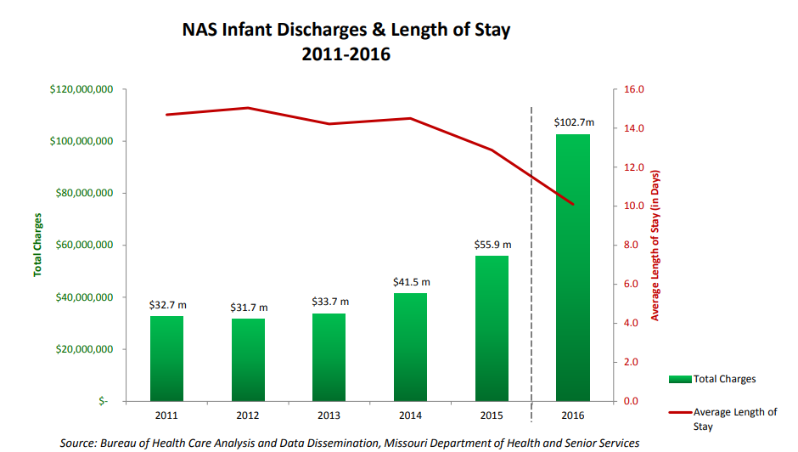
Notes:
The frequency and total charges related to NAS have seen increases (such as the charge data displayed by the green bars above) between 2011 and 2016. However, the length of stay from birth until discharge from the hospital (represented by the red line in the chart above) has decreased by 31% during the same time period. *
Charts displaying NAS data for length of stay, charges, and insurance payer are based upon total discharges during the first year of life; so potentially multiple records for the same child are included in these statistics. Note that not all the NAS cases have associated charges

Slide 13
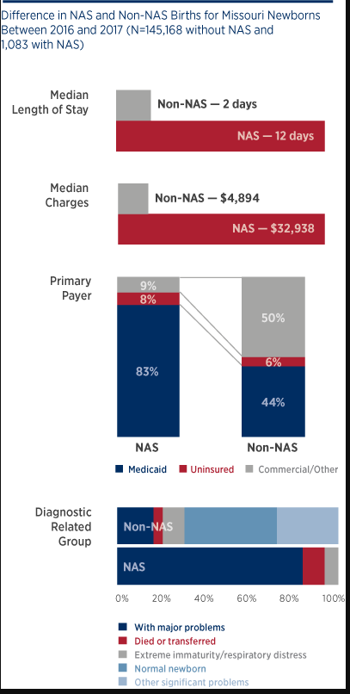
Reidhead M, Kinkade B, Williams A. MHA Policy Brief, June 2018
Notes:
Data obtained from conventional source, newborn discharge diagnoses codes, felt to be an underestimation
Data from the Missouri Hospital Association outlined difference in LOS and cost for non-NAS versus NAS
Ave LOS 10 days longer for NAS
Missouri Medicaid pays for 83% of NAS deliveries

Slide 14
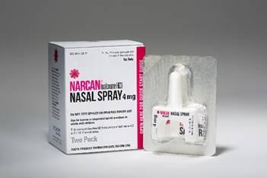
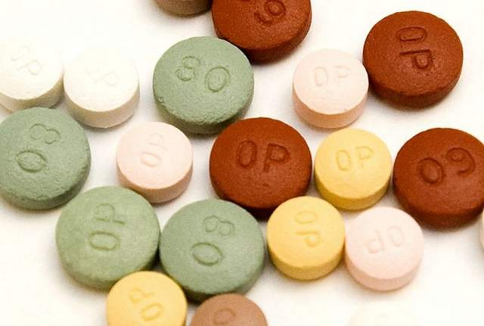
Common Narcotic Agonists and Antagonists
Opiates
Codeine
Morphine
Opium
Opioids
Fentanyl
Heroin
Hydromorphone (Dilaudid)
Meperidine
Methadone
Oxycodone
Propoxyphene
Buprenorphine
Antagonists
Naloxone
Naltrexone
Partial Agonists
Pentazocine (Talwin)
Nalbuphine (Nubain)
Butorphanol (Stadol)
Buprenorphine (Subutex)
Notes:
Opiates are alkaloid compounds extracted from opium like morphine, heroin and codeine.
Opioids are semisynthetics like heroin, demerol and methadone
Mode of ingestion

Slide 15
Medical Complications of Maternal Opioid Use
Infections
STIs (HIV)
Endocarditis
Pneumonia
Cellulitis and abscesses
TB
UTI
Hepatitis (acute and chronic)
Abuse of other substances
Mortality
Suicide
Trauma
OD
Nutritional deficiencies and anemia
Tetanus
Thrombophlebitis and edema
Psychiatric disease
Depression
Anxiety
Bipolar
High risk behaviors
Theft
Violence
Legal risks
Trading sex for drugs or being trafficked
ACOG, Committee Opinion 711. Obstet Gynecol 2017;130:e81-85

Slide 16
Prenatal Opioid Abuse or Dependence and Obstetric Outcomes: 2007-2011 (Nationwide Inpatient Sample)
Condition with Significant Differences | Adjusted Odds Ratio, opioid vs without
Died during hospitalization | 4.6
Cardiac arrest | 3.6
Growth restriction | 2.7
Placental abruption | 2.4
LOS > 7 days | 2.2
Preterm | 2.1
Oligohydramnios (low amniotic fluid) | 1.7
Transfusion | 1.7
Stillbirth | 1.5
Premature rupture of membranes | 1.4
Cesarean delivery | 1.2
Maeda A, et al. Anesthesiology 2014;121:1158-65
Notes:
Review of over 57 million American women admitted for delivery in the Nationwide Inpatient Sample
After controlling for age, race, payor, previous cesarean, multiples, preexisting medical conditions
Table 3 for substance abuse talk

Slide 17
Neonatal Abstinence Syndrome
GI dysfunction
Poor feeding
Uncoordinated sucking
Vomiting
Diarrhea
Dehydration
Poor weight gain
Autonomic signs
Increased sweating
Nasal stuffiness
Fever
Mottling
Temperature instability
Neurologic excitability
Tremors
Irritability
Wakefulness
High-pitched cry
Increased tone
Hyperactive reflexes
Exaggerated Moro
Seizures
Increased sweating
Frequent yawning and sneezing
Kocherlakota P. Neonatal Abstinence Syndrome. Pediatrics 2014;134;e547-61
Notes:
The neonatal abstinence Finnegan scoring system is the most widely used of these methods and assesses 31 specific clinical features. Pharmacologic therapy is generally started with three or more scores above eight, or two scores above 12. Each institution decides upon the number of consecutive scores below a threshold value for initiation of weaning.
Timing, onset, severity of symptoms vary by opioid

Slide 18
Criteria for Diagnosing Substance Use Disorders: DSM V
Increasing tolerance
Withdrawal symptoms
Using larger amounts or for longer than intended
Wanting to cut down or stop, but not managing to
Spending a lot of time to get, use or recover from drug use
Craving
Inability to manage commitments due to drug use
Continuing to use, even when it causes problems in relationships
Giving up important activities because of drug use
Continuing to use, even in dangerous situations
Continuing to use, even when physical or psychological problems may be made worse by drug use
< 2 = no disorder
2-3 = mild disorder
4-5 = moderate disorder
> 6 = severe disorder
Notes:
Used to refer to these disorders as substance abuse (shaming).
Substance misuse refers to milder forms. The DSM V combines the two previously characterized disorders of substance abuse and substance dependence into a single disorder, with mild moderate or severe sub-classifications
Addiction is characterized by have a severe substance use disorder (compulsive use)
Not an “all or none”. Addiction occurs over time and is progressive.
It is therefore advisable to identify emerging disorder and intervene (evidence based) to stop the process before it becomes more chronic, more complex, and difficult to treat.
Definition of addiction
Addiction is a primary, chronic disease of brain reward, motivation, memory and related circuitry. Dysfunction in these circuits leads to characteristic biological, psychological, social and spiritual manifestations. This is reflected in an individual pathologically pursuing reward and/or relief by substance use and other behaviors.
Addiction is characterized by inability to consistently abstain, impairment in behavioral control, craving, diminished recognition of significant problems with one’s behaviors and interpersonal relationships, and a dysfunctional emotional response. Like other chronic diseases, addiction often involves cycles of relapse and remission. Without treatment or engagement in recovery activities, addiction is progressive and can result in disability or premature death.

Slide 19
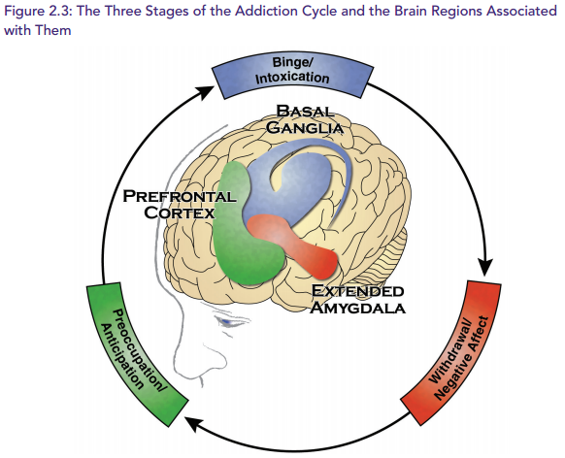
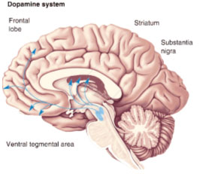
Notes:
Manifests differently in different individuals, duration of these cycles vary by individual and by drug.
Addiction cycle tends to intensify over time
Impulsive use gives way to compulsive use
Positive reinforcement gives way to negative reinforcement
Early: Yawning,, Lacrimation, craving. Sweating, irritability, rhinorrhea, hot and cold
Intermediate: Gooseflesh, dilated pupils, flushing, tachycardia, twitching, tremor, restlessness, Rhinorrhea, Flushing, Nausea, Vomiting, Tachycardia, Abdominal cramps, Irritability, Anxiety, Anorexia
Late
Diarrhea, Muscle spasms, Vomiting, Bone and joint aching, Restlessness, Irritability, Insomnia, Sneezing, Hypertension, Increased resp. rate, Tachycardia

Slide 20
i
Alex Walley, MD
Notes:
The transition from acute to chronic use.
The modulation moves from Normal-Euphoric to Normal-Withdrawal. Consider living life fully vs. living life obsessed with cravings and feeling physically ill.
The opioid dependent person chases the Normal through continued opioid use. The euphoria is but a memory—but a powerful memory nonetheless.

Slide 21
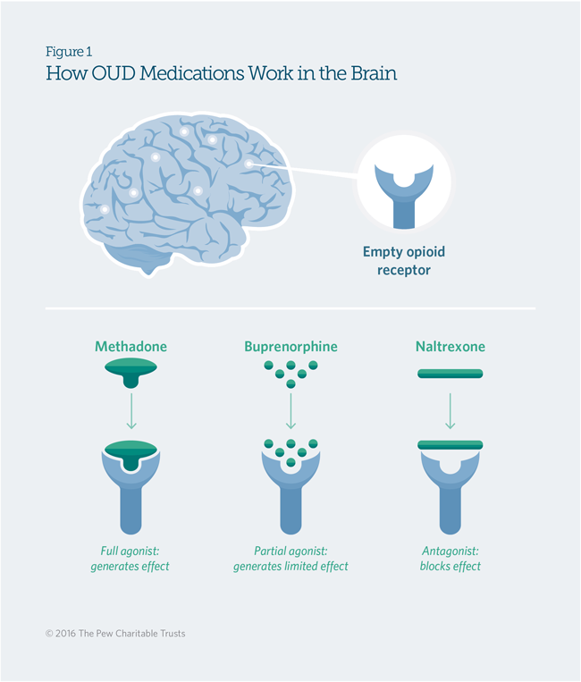
Medication First Model – Why?
Fairly immediate relief from distress caused by withdrawal symptoms
Stabilizes the client
Decreases craving
Creates mental ability for patient to engage and benefit from psychosocial treatments
Increased retention in treatment
Decreased deaths from overdose
Notes:
Same thing – connect people first with the thing they need the most. The sooner we can help people get to a place where they can participate in recovery, the sooner they can be in recovery

Slide 22
Alex Walley, MD
Notes:
Maintenance agonist tx brings people out of that… back into the white
This graph represents the opioid-dependent brain and brain chemistry, NOT an opioid naïve brain.

Slide 23
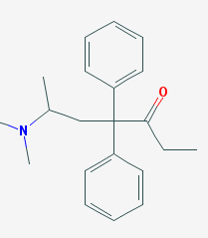
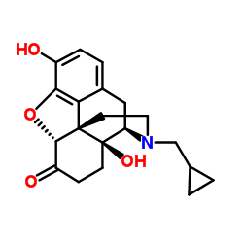
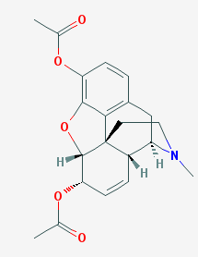
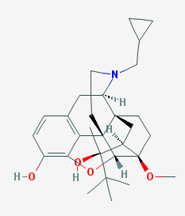
Alternative Treatments for Narcotic Addiction
Methadone, Full agonist
Naltrexone,
Opioid antagonist
Buprenorphine,
Partial agonist
Detox,
of limited utility alone
Heroin
Notes:
Discuss medication replacement therapy

Slide 24
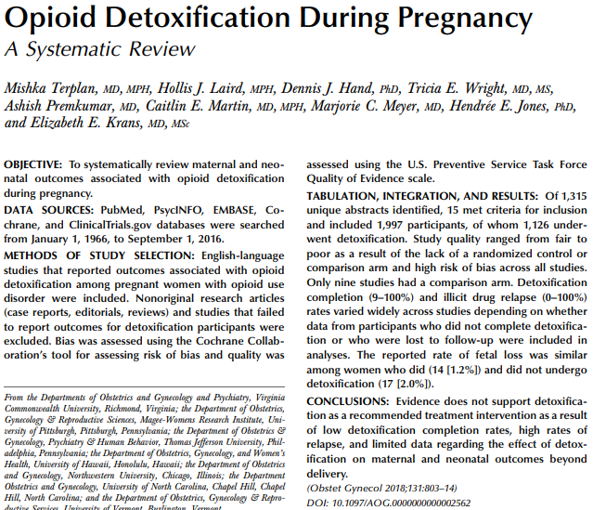

Slide 25
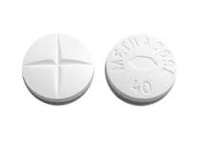
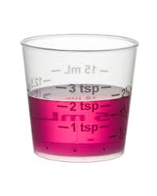
Methadone
Full opioid agonist – a synthetic opioid
Gold standard
Well known to the medical community with data to support effectiveness in community-based OTP settings
Full agonist action increases dopamine and neurotransmitter function
Limited by geography
Notes:
Safe and effective with OTP service wrap-arounds
Great dopamine push
However, it’s availability is limited to those who can access OTP’s
It has overdose potential due to respiratory depression

Slide 26
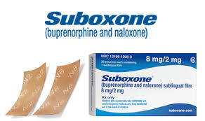
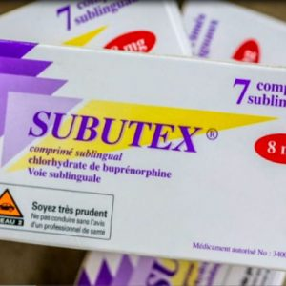
Buprenorphine
Partial opioid agonist—a synthetic opioid
Buprenorphine (Subutex)
Buprenorphine/Naloxone (Suboxone)
New depot formulation (Sublocade)
Probuphine implant
Can be prescribed by a waivered physician, NP or PA
Partial agonist action increases dopamine and neurotransmitter function
Research shows it works in community-based practices from any medical specialty
Notes:
Formulations with naloxone decrease potential for misuse.
Low overdose potential due to ceiling effect
Plenty of studies indicate efficacy.
Can start while someone’s in withdrawal, don’t need to wait multiple days like Vivitrol

Slide 27
Pregnancy Benefits of Methadone or Buprenorphine Maintenance
Decreases illegal opiate use and other drugs
Slows the spread of HCV, AIDS and other STDs
Decreases crime
Prevents fluctuation of maternal drug level over course of the day
Reduces maternal mortality and severe morbidity
Decreases risk of neonatal stress due to more stable intrauterine environment
Improved birth weight compared to women on heroin
Reduction in neonatal mortality compared to women on heroin
Therefore, narcotic replacement therapy with methadone or buprenorphine is the standard of care for pregnancy

Slide 28
Illicit Drug Use
No medication
Suboxone
Methadone
Hser, Yih‐Ing, et al. "Long‐term outcomes after randomization to buprenorphine/naloxone versus methadone in a multi‐site trial." Addiction (2016).
Notes:
START study randomized 1269 individuals to BUP or MET
Higher dropout in BUP arm, half-way through randomization scheme changed from 1:1 to 2:1

Slide 29
Pharmacokinetics of Methadone Altered by Pregnancy
Increased plasma volume and volume of distribution
Fraction of oral methadone absorbed is decreased
Half-life decreased due to increased hepatic clearance
Protein binding decreased
High degree of individual variability in methadone metabolism in pregnancy

Slide 30
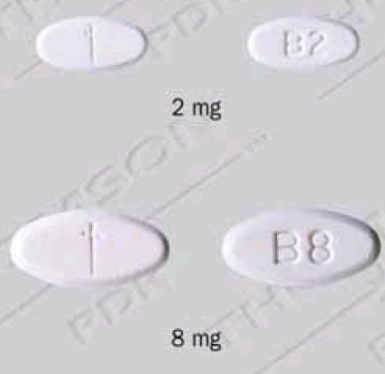
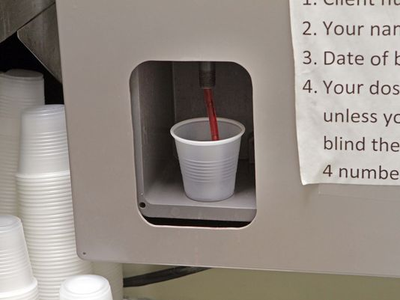
Methadone Vs Buprenorphine
 | Methadone | Buprenorphine
Dosing | Daily (sometimes twice) | Once or twice daily
Route | Oral | Sublingual
Location | Federally licensed OTP | Office-based, by wavered physician, PA or NP
Initiation | OTP or hospital Withdrawal not necessary | Office or hospital Moderate withdrawal
Retention | Greater (78%) | Lower (57.7%)
Diversion risk | ++ | +++
Risk of OD | ++++ | ++ (especially with benzo)
Dose | 60-150 mg | 8-24 mg, ceiling effect
Convenience | Less | Much greater
Notes:
Difference between Subutex and Suboxone

Slide 31
Methadone Vs Buprenorphine
 | Methadone | Buprenorphine
Counseling | On site | +/-
Treatment for Psych | No | +/-
Polysubstance Use | Preferred or for long-standing | May be better for newer users or prescription abuse
NAS | 57% | 47%
NAS treatment (d) | 9.9 d | 4.1 d
Breastfeeding safety | Safe | Safe
Neurodevelopmental outcome | Same as controls matched for age, race and SES | Limited data, appears safe

Slide 32
Other Factors to Consider for Methadone versus Buprenorphine
 | Methadone | Buprenorphine
FDA approved in pregnancy | Yes | No
Failure rate | + | +++
Drug interactions | +++ | +++

Slide 33
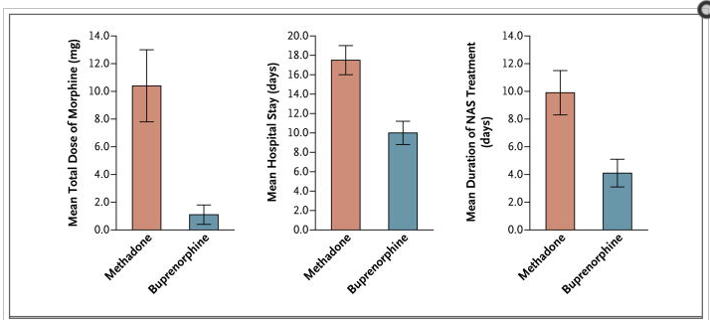
Neonatal Abstinence After Methadone or Buprenorphine Exposure
Double Blind, multicenter RCT in 175 pregnant women
Jones HE, et al. NEJM 2010;363;2320-31

Slide 34
Retrospective Methadone v. Buprenorphine: Newborn Outcomes
 | Methadone (N=248) |  | Buprenorphine (n=361) |  | p
Infant Characteristics | n | M (SD) or (n%) | n | M (SD) or n (%)
EGA at delivery | 248 | 38.2 (2.5) | 361 | 39.2 (2.2) | <0.001
Preterm (<37w) | 248 | 43 (17%) | 361 | 36 (10%) | <0.001
Birth weight (grams) | 248 | 2899.7 (583.1) | 361 | 3143.3 (578.9) | <0.001
HC (cm) | 209 | 33.0 (2.0) | 279 | 33.6 (2.1) | <0.001
Treated for NAS | 245 | 106 (42%) | 358 | 82 (23%) | <0.001
Days of NAS rx | 106 | 133 + 83 | 79 | 83 + 60 | <0.001
LOS (d, EGA > 37w) | 205 | 5.6 (2.8) | 325 | 4.2 (12.6) | 0.107
Breast Milk at discharge | 247 | 156 (63%) | 358 | 267 (75%) | 0.003
Discharge to mother/family | 248 | 237 (96%) | 360 | 351 (98%) | 0.189
Meyer MC, et al. J Addict Med 2015;9:81-86

Slide 35
Treatment of Addiction in Pregnancy
Notes:
Medication:
MAT
Psychiatric co-morbidity
Team approach

Slide 36
OUD: Prenatal Care (1)
Identification and treatment of infectious diseases (HIV, HCV, STDs)
Vaccine for hepatitis A and B if serology negative
Fetal well-being
Fetal growth
Non-stress testing, when indicated
Investigate fetal morphology
Preterm labor prevention and education
Lactation and pediatric (NAS) education
Notes:
Multidisciplinary team

Slide 37
OUD: Prenatal Care (2)
Management of addiction
Chemical dependency counseling
Methadone or buprenorphine
Relapse prevention, identification and management
Urine drug testing
Identification and treatment of psychiatric co-morbidities
Anesthesia consultation when cesarean delivery planned or if epidural analgesia contraindicated
Drug interactions between buprenorphine, methadone and many other medications
Notes:
Multidisciplinary team

Slide 38
Post-Partum
Encourage breastfeeding when appropriate
Infants stay in the hospital for 5-7 days
Rooming in (always)
Upon maternal discharge, we provide courtesy room
Consistency of care from antepartum to post-partum
MFM
WISH Social workers

Slide 39
Neonatal Abstinence Syndrome
GI dysfunction
Poor feeding
Uncoordinated sucking
Vomiting
Diarrhea
Dehydration
Poor weight gain
Autonomic signs
Increased sweating
Nasal stuffiness
Fever
Mottling
Temperature instability
Neurologic excitability
Tremors
Irritability
Wakefulness
High-pitched cry
Increased tone
Hyperactive reflexes
Exaggerated Moro
Seizures
Increased sweating
Frequent yawning and sneezing
Kocherlakota P. Neonatal Abstinence Syndrome. Pediatrics 2014;134;e547-61
Notes:
The neonatal abstinence Finnegan scoring system is the most widely used of these methods and assesses 31 specific clinical features. Pharmacologic therapy is generally started with three or more scores above eight, or two scores above 12. Each institution decides upon the number of consecutive scores below a threshold value for initiation of weaning.
Timing, onset, severity of symptoms vary by opioid

Slide 40
NAS Symptoms and Feeding
NAS severity increased by excess environmental stimulation and hunger
Increased stimulation increases GI problems
Therefore, low stimulation environment encouraged
McGrath JM. Vermont Oxford, NAS Microlessons, Feeding and Nutritional Support: Engaging Families
Notes:
Support mother to recognize infant cues
Hunger vs discomfort
Satiation
Engage mother in understanding her infant behavior
Praise mother for dyadic interaction
Timing, pace, and avoiding interference with feeds
Avoid multi-tasking during feeding
By discharge mother should feel comfortable providing all feedings

Slide 41
Academy of Breastfeeding Medicine Clinical Protocol #21 Guidelines for Breastfeeding and Substance Use or Substance Use Disorder, Revised 2015
Who Should Breastfeed?
In substance abuse treatment and has given consent to communicate
Counselors/Providers confirm sobriety
Plan to continue treatment postpartum period
UDS negative for 90 days prior to delivery and in an outpatient setting
Negative UDS at time of delivery
Received consistent prenatal care
Who Should NOT Breastfeed?
No prenatal care
Relapsed within 30 days of delivery
Not willing to engage in treatment and/or will not give consent for communication among providers
Positive UDS at time of delivery
No plans for postpartum treatment or pediatric care
Demonstrating behavioral qualities or other indicators of active use
Case by Case
Relapse in the 90-30 days prior to delivery, but screen negative in the last 30 days
Use of other medications incompatible with lactation
Started prenatal care and/or substance use treatment during or after the second trimester
Sobriety in an inpatient setting only

Slide 42
Breastfeeding and Methadone and Buprenorphine
AAP considers methadone and buprenorphine as compatible with breastfeeding regardless of dose
124 women receiving opioid maintenance
Breastfeeding reduced the need for withdrawal treatment in opioid-exposed infants on opioid maintenance therapy (53% vs 80%)
Infants on BMT and MMT who breastfed had shorter treatment for NAS
Welle-Strande, GK, et al. Acta Paediatrica 2013;102:1060-6
Notes:
Methadone concentrations in milk 0.11-0.18 mg/L, average 0.132 mg/L. Milk to plasma ratio of .66

Slide 43
How much is really in that milk?
Methadone
RID 1.9%-6.5% (ave 2.8%)
Not related to maternal dose
Buprenor-phine
Clinically insignificant
RID 0.09%-1.9%
clinically insignificant
Hale, T. W., & Rowe, H. E. (2016). Medications and Mothers' Milk 2017. Springer Publishing Company.
Notes:
Examples of education for moms and
Critical points to understand – everyone needs to be on the same page

Slide 44
Why is the Mom-Baby Relationship Important?
Babies go home
Home environment can be more impactful than effects of in utero exposure
Breastfeeding = Oxytocin
Strengthens the bond, increases protective behaviors, decreases cortisol (stress) levels
Strong Bond
Strong attachment to baby provides incentive to stay sober

Slide 45
Breastfeeding is important – but not always easy
Set Realistic Expectations
“No Failure Zone”
It can, and does work for many.
It can be stressful under any circumstances.
It does not have to be “all or nothing”.
Breastfeeding is part of a number of non-pharmacologic measures.
Every effort to positively parent should be encouraged, supported, and congratulated.
Help moms identify the successes.
Notes:
Mothers
Guilt
Victimization
Conflicting advice
Lack of self-confidence
Providers
Lack of clear guidelines
Stigma
Lack of skills to facilitate lactation in a mother infant dyad with special needs

Slide 46
Early Success
Empower mom to positively contribute to infant's care
Sustained Sobriety
Strong mother-infant bond increases protective behaviors
Stable Environment
Allows for improved outcomes
Strengthened Families
Provide a network of support and guidance
The Center for the Study of Social Policy. (2017). Strengthening Families: A Protective Factors Framework. Retrieved from https://www.cssp.org/young-children-their-families/strengtheningfamilies/about#state-strengthening-families-partners
Notes:
Model created when women are the primary care-givers in the hospital

Slide 47
Weighing the trade-offs Is the Risk of not breastfeeding too high?
Assured no additional exposure to illicit drugs while baby is hospitalized
Risks associated with not receiving human milk
Mom with no increased mothering hormones
No breast-feeding:
Less skin-to-skin
No assurance of time with mom

Slide 48
Conclusions, Treatment Options for Opioid Addiction in Pregnancy
Opioid replacement medication is the standard of care
Methadone is still considered the first line, only FDA approved medication for narcotic replacement therapy in pregnancy, but buprenorphine is an excellent alternative, even as a first line
Care for this population requires a multidisciplinary approach
Breast-feeding should be encouraged in women abstinent from illicit opioids

Slide 49
Thank You from WISH (Women and Infants Substance Use Help) Center
314 768-8230

